Slide 1
ARIS Express
How to import ARIS Express models into ARIS

Slide 2
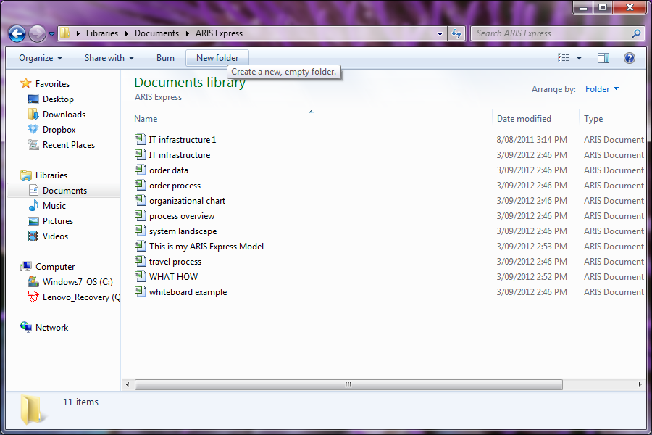
Backing up ARIS Express Models
ARIS Express models are saved by default to the document libraries

Slide 3
Restoring ARIS Express Models
It is advised to restore the models in a separate database, so it may be standardised with your organisation’s conventions before merging it to the development database

Slide 4
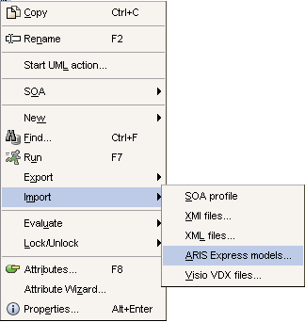
Restoring ARIS Express Models (continued)
Right click on the relevant working folder and select Import. Select ARIS Express models

Slide 5
Restoring ARIS Express Models (continued)
Navigate to where the models are saved
Select the required models and click Import:

Slide 6
Restoring ARIS Express Models (continued)
Determine whether the configuration is to be extended:
Extend configuration and import ADF files
First extends the configuration by the ARIS Express filter and the ARIS Express model template. Then the ARIS Express models (ADF files) are imported. This ensures that the models have the same appearance as in ARIS Express and that you can continue working with the same object symbols.
Import ADF files only
Existing filters are not extended by the ARIS Express filter and the ARIS Express model template. The object symbols from ARIS Express cannot be used with this and the models do not have the appearance they have in ARIS Express

Slide 7
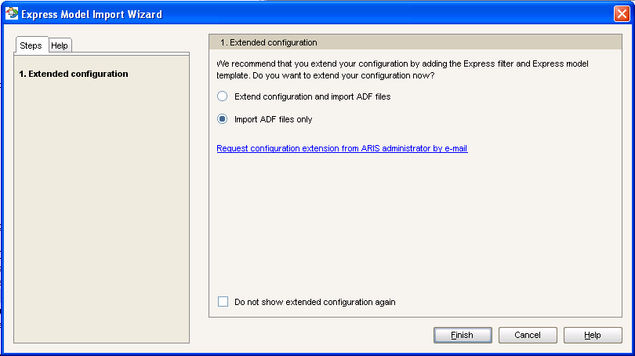
Restoring ARIS Express Models (continued)
For this example only the ADF file was imported
Select Finish to action

Slide 8
Restoring ARIS Express Models (continued)
This will start the model import:

Slide 9
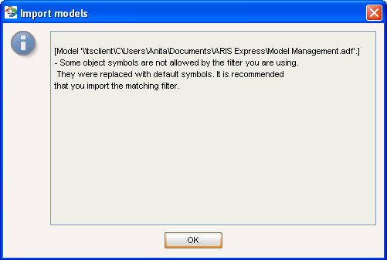
Changing object appearance
Once import completes the wizard will advise that the objects have been changed to default:

Slide 10
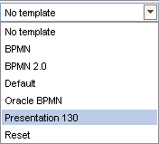
Changing object appearance
The appearance may also be changed by applying your organisation’s template:

Slide 11
Merging models to development database
Login to the relevant development database
Right click and drag the required model to the target database
When prompted, select Merge

Slide 12
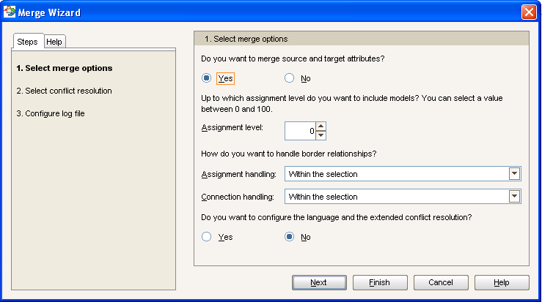
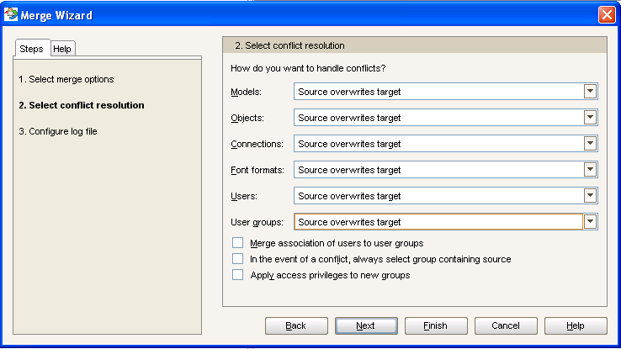
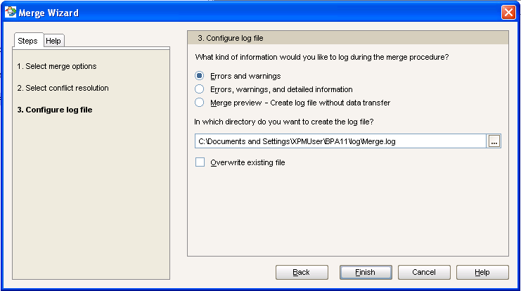
Merging models to development database (continued)
Select the appropriate merge requirements:

Slide 13
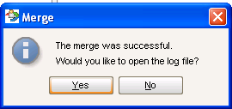
Merging models to development database (continued)
This will initiate and finalise the merge:

Slide 14
Consolidating objects
In instances where library objects, such as application systems, were used, object consolidation will be required

Slide 15
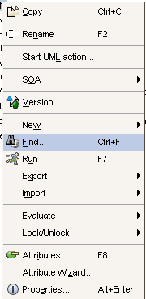
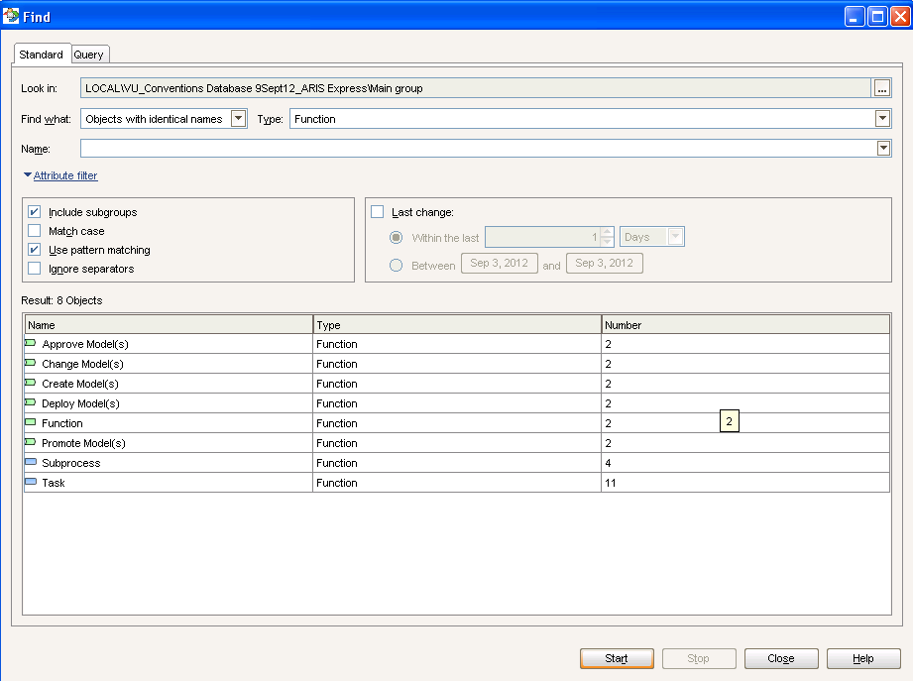
Consolidating objects (continued)
Look for objects using Find function
In this example the search was conducted on functions with the same name:

Slide 16
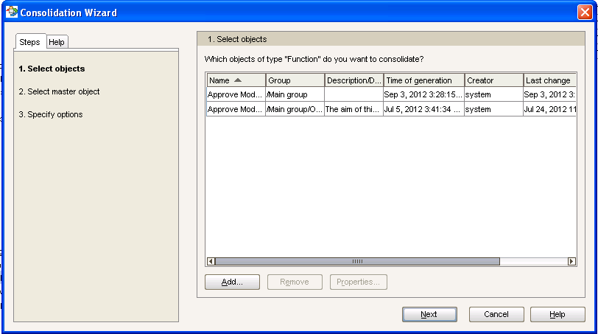
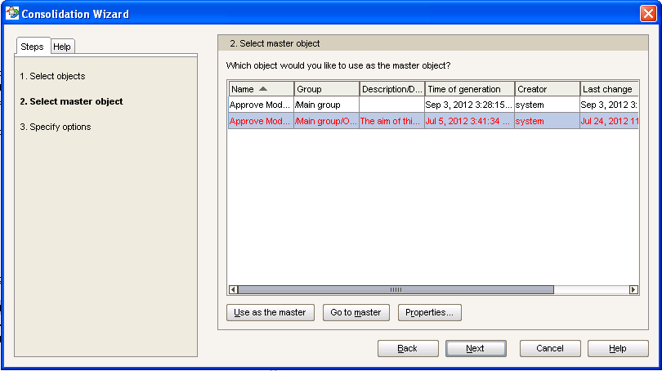
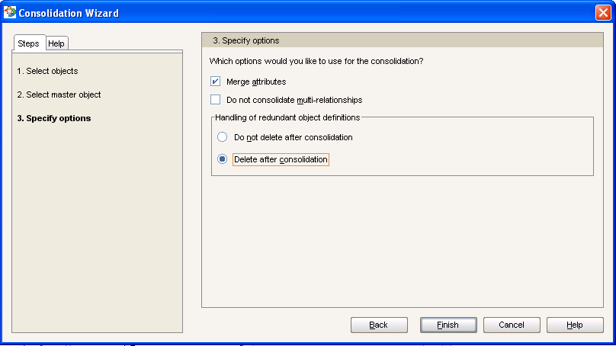
Consolidating objects (continued)
Determine objects to consolidate and identify master:

Slide 17
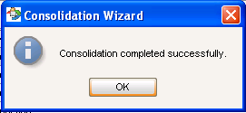
Consolidating objects (continued)
This will initiate and finalise the consolidation:

